Slide 1
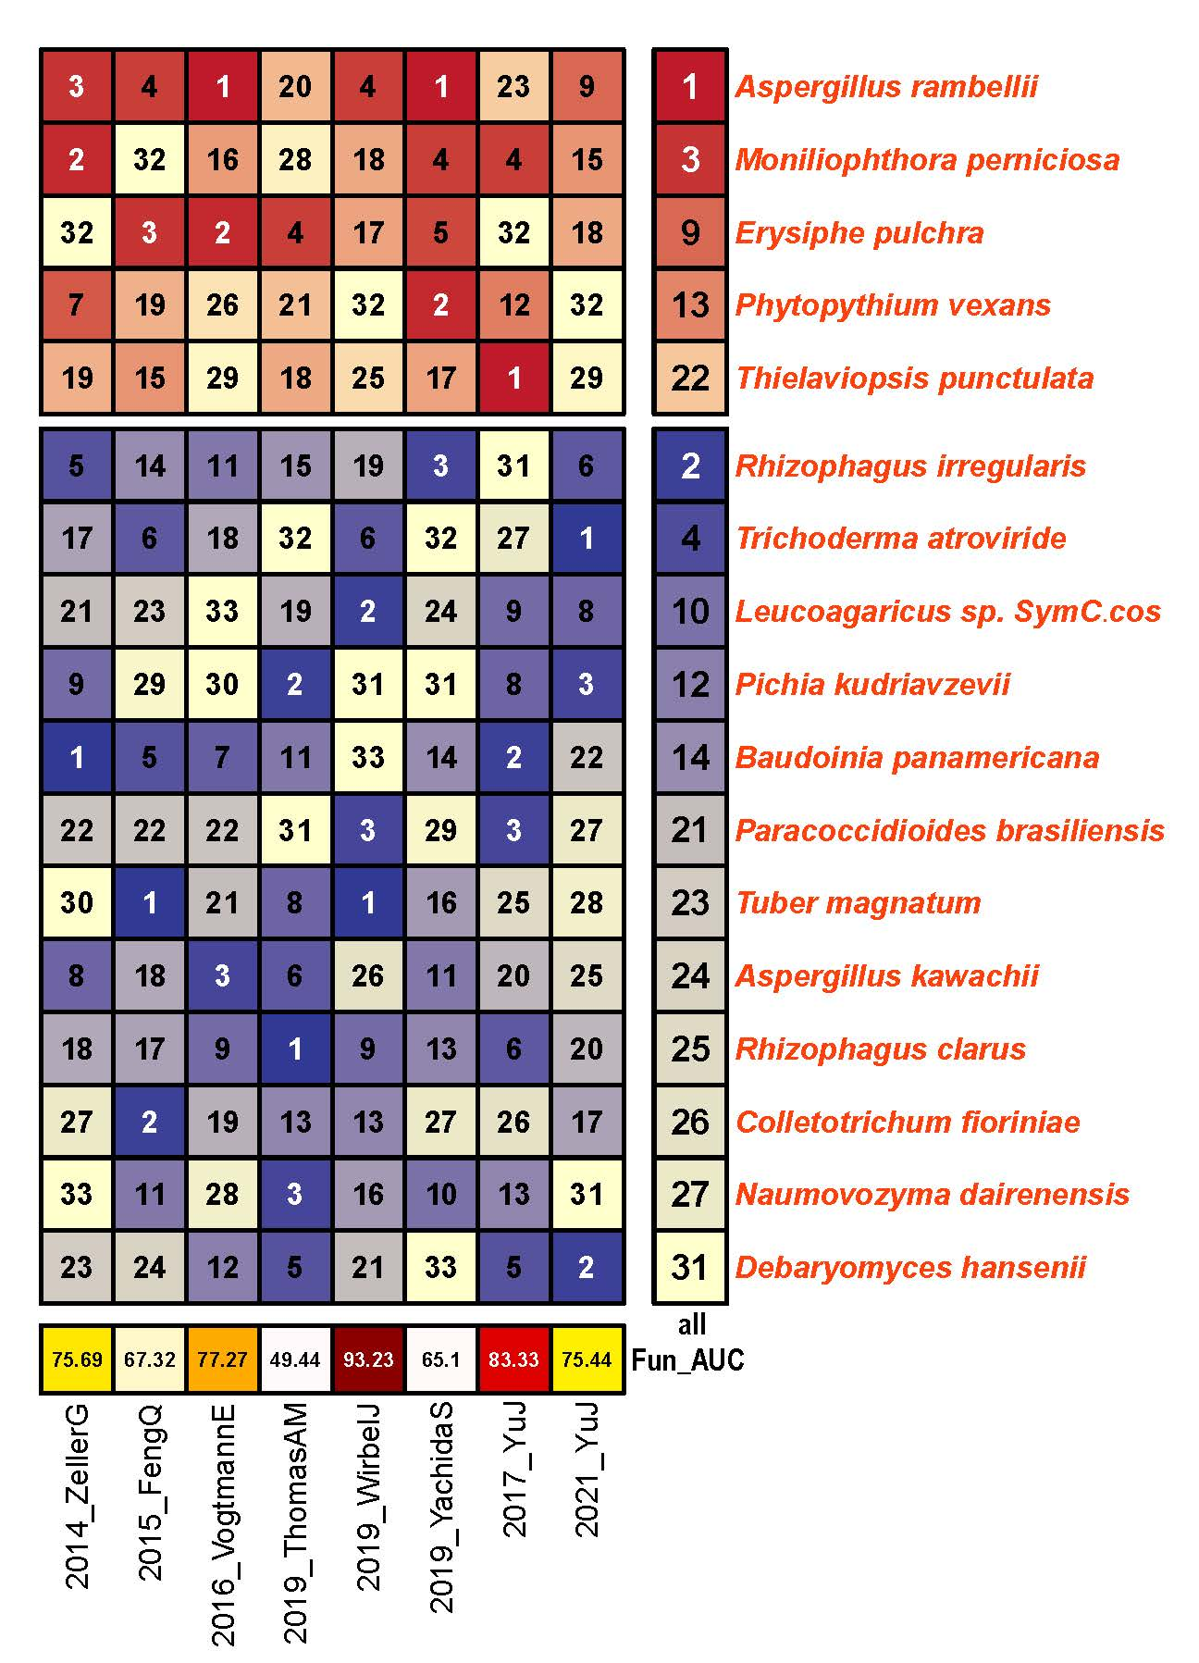
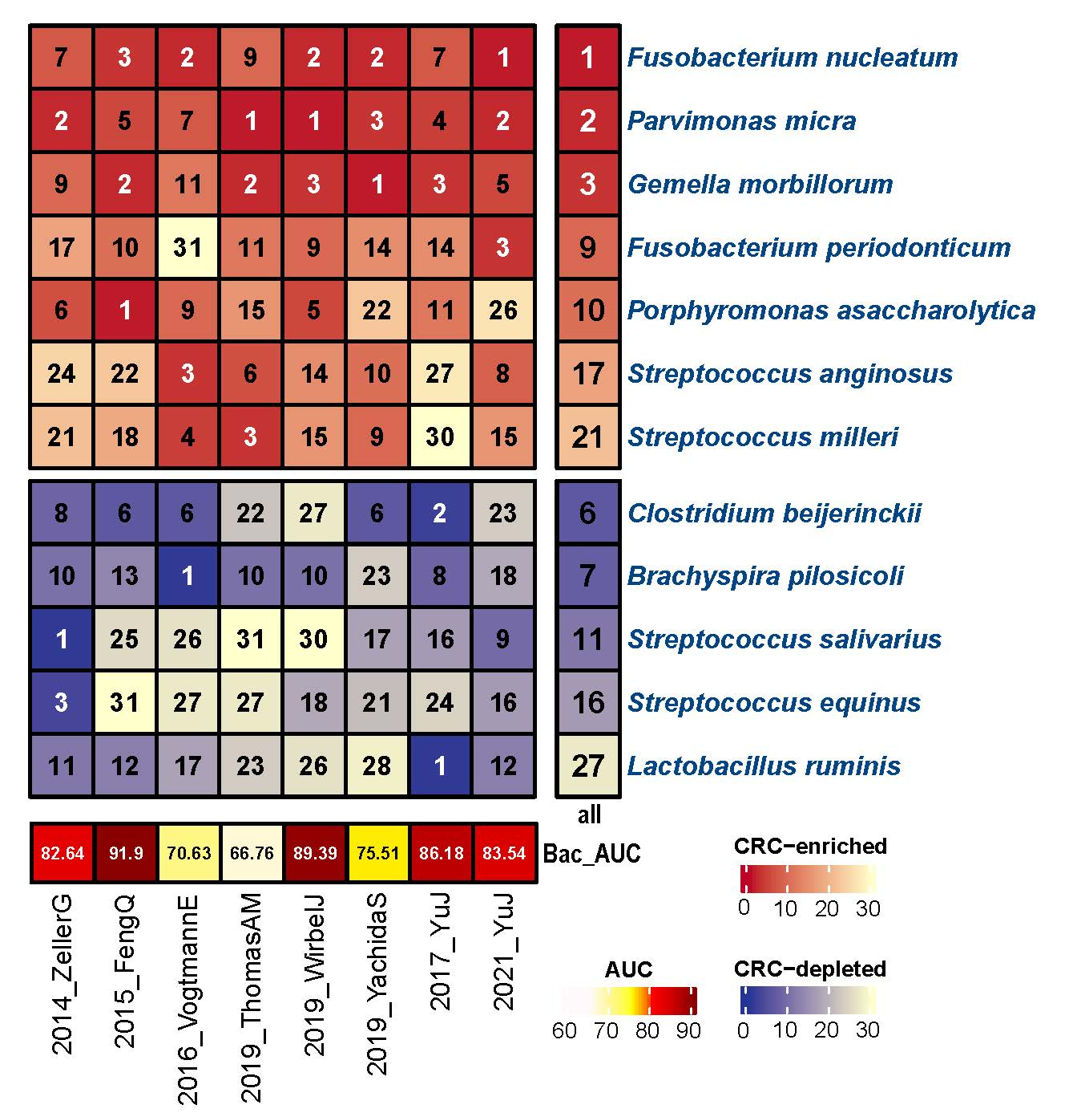
a
b
S figure 7 Feature ranking and performance of pure CRC-diagnosis models across 8 cohorts. (a) Top panel: The importance of each fungi for the cross-validation prediction performance in each cohort estimated using the internal random forest scores. Only fungi appearing in the three top-ranking features in at least one dataset were reported. Bottom panel: AUC performance of CRC-diagnosis models across 8 cohorts. (b) Same as above, but the candidate became the bacteria.

